Slide 1
Metal Detector Circuit Design Project
EGR 330
Cole Brauer, Michaela Dye, Jacob Knaup, Shelby Reed

Slide 2
Design Description
Beat Frequency Oscillator (BFO) Metal Detector
Circuit uses 2 inductors (a reference coil and a search coil) and an amplifier network
The coils are initially tuned to the same frequency but a disturbance of metal by the search coil causes the network to become unbalanced and its output signal will change
The circuit contains several stages of amplification to boost the signal changes so they can be audible through the speaker

Slide 3
Materials
1 - 9V rechargeable battery
2 - 220 μF 16V electrolytic capacitors
5 - 0.01 μF polyester capacitors
5 - 0.1 μF polyester capacitors
6 - 10 kΩ resistors
1 - 1 kΩ resistor
1 - 2.2 MΩ resistor
2 - 39 kΩ resistors
6 - 2N2222A transistors
1 - speaker
1 - ProtoBoard (8.25 cm x 6.5 cm)
.25 mm enameled copper wire
1 - 15 cm diameter circle from 3 mm plywood
2 - 16 cm diameter circles from 3 mm plywood
1 - 117 cm long rod for handle
1 - 12 mm diameter and 50 mm long dowel rod
1 - 5 cm plastic threaded PVC pipe
1 - brass nut to fit plastic tube

Slide 4
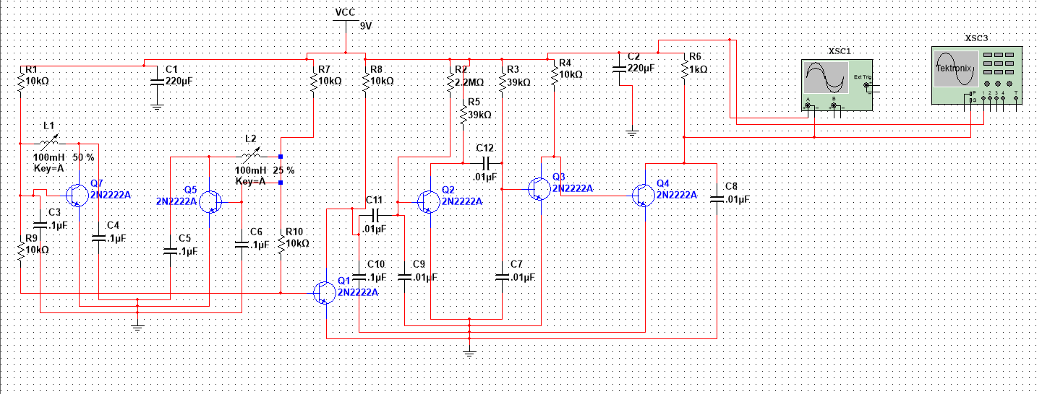
Multisim Model

Slide 5
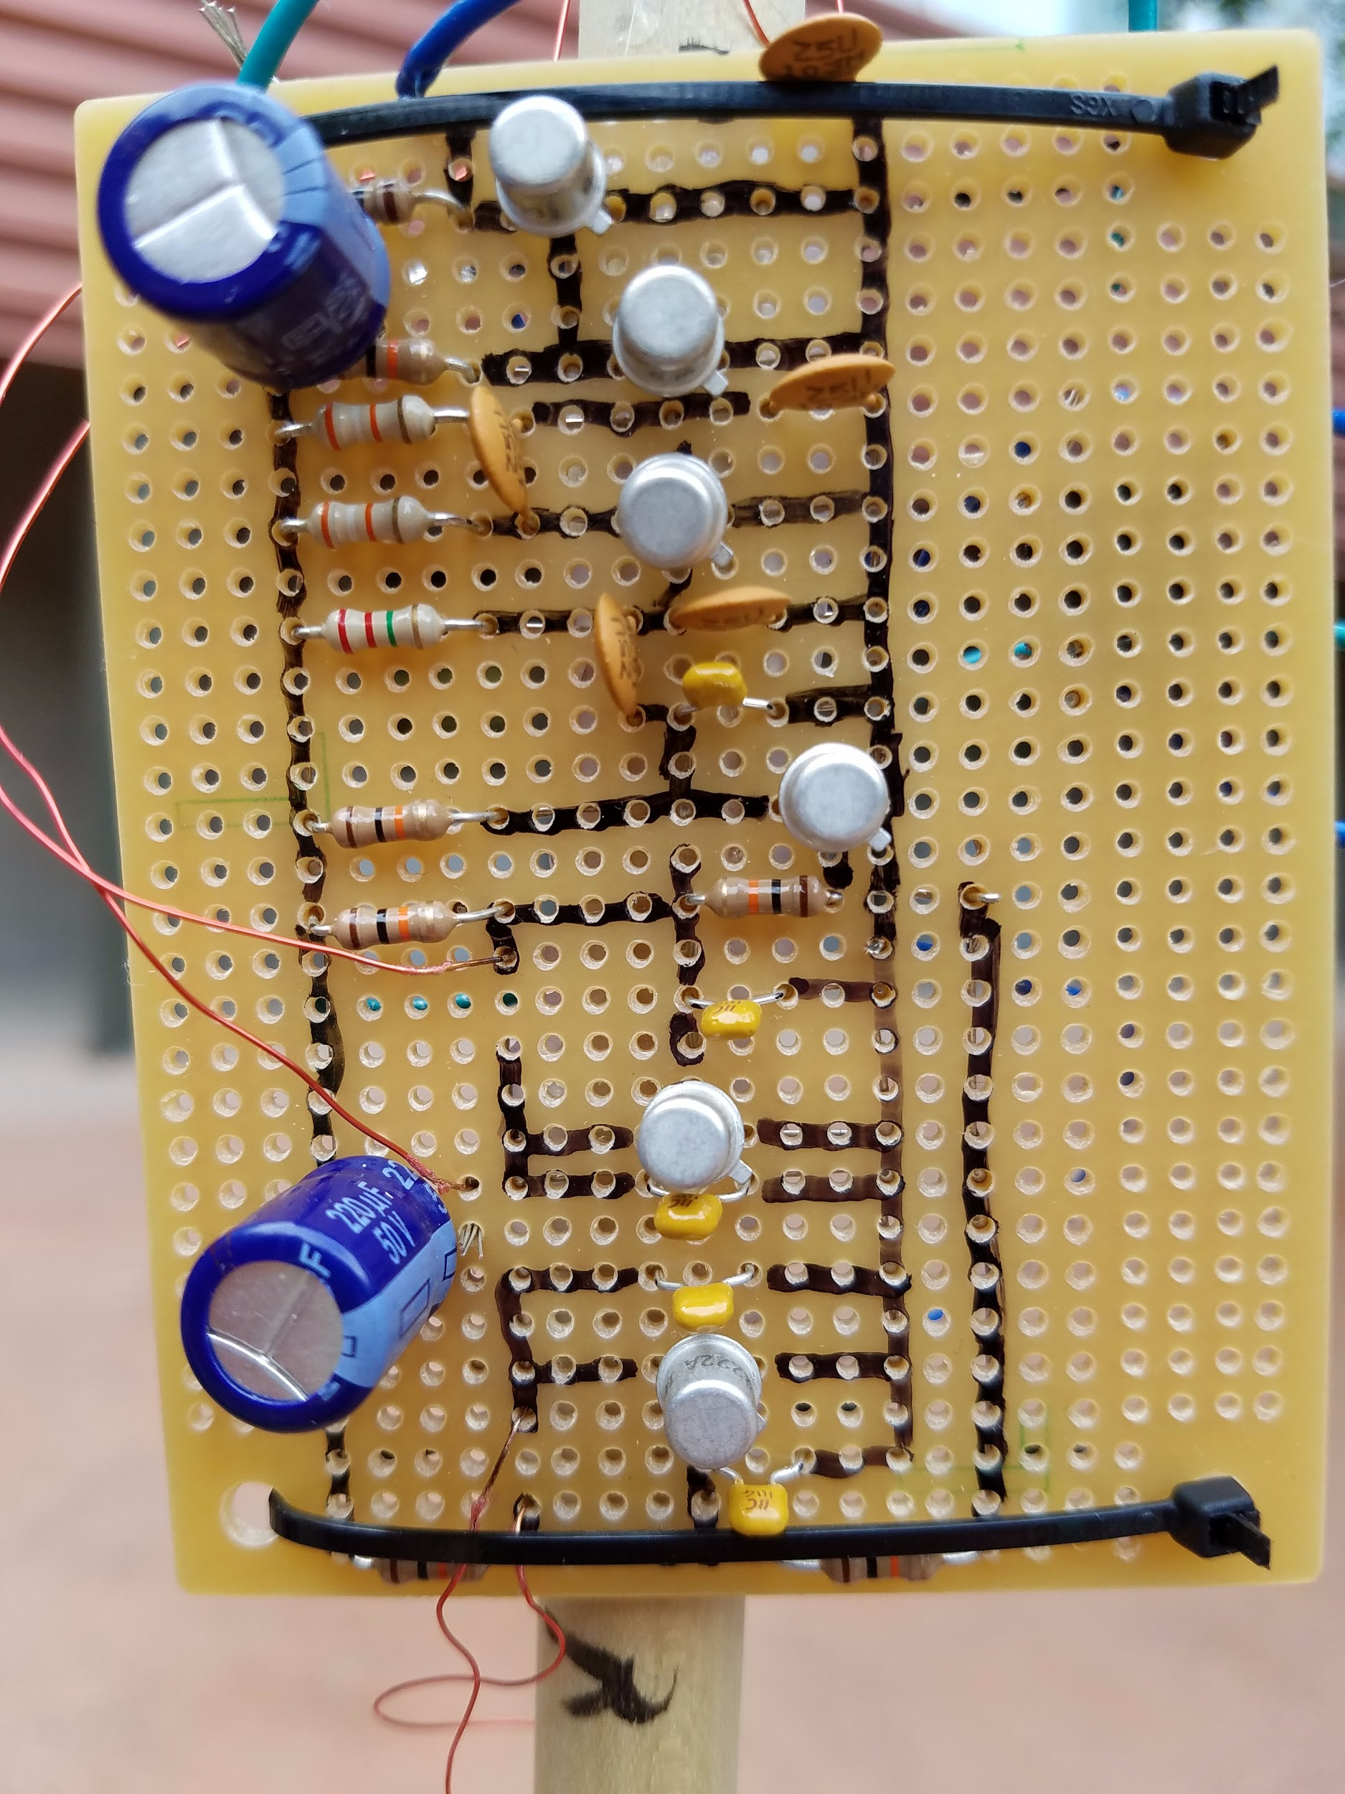
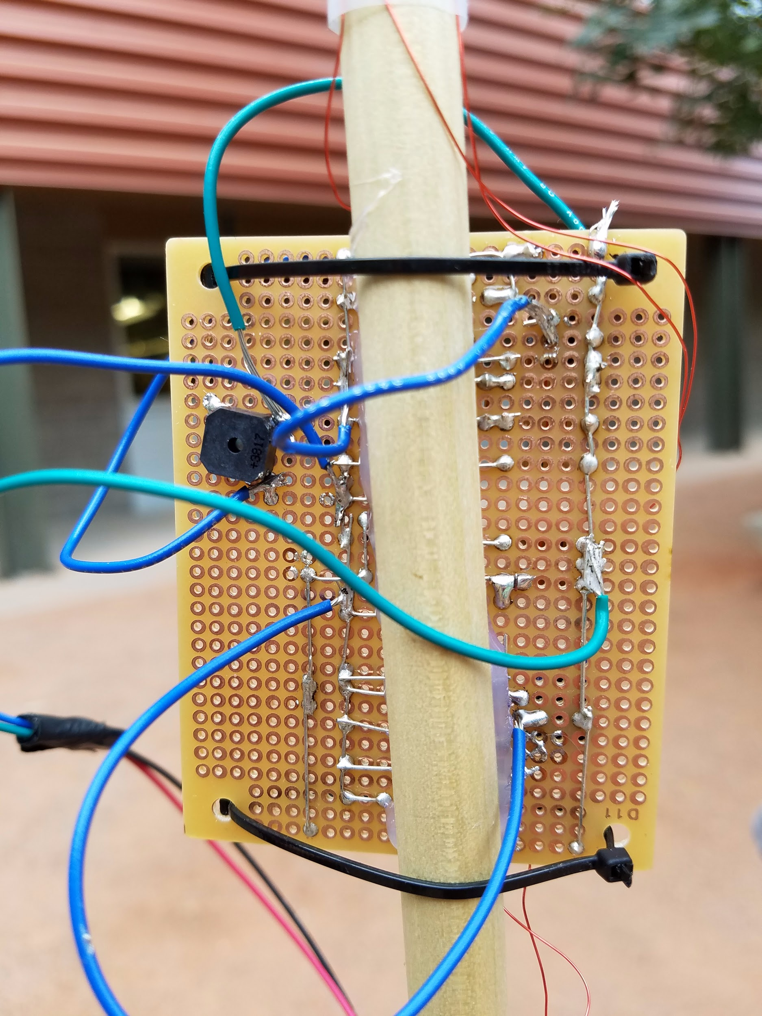
The Circuit
This is the front and back of our circuit. We implemented the circuit on a proto board which allowed us to attach the circuit directly to the metal detector rod without worrying about wires being pulled out if we would have used a breadboard.

Slide 6
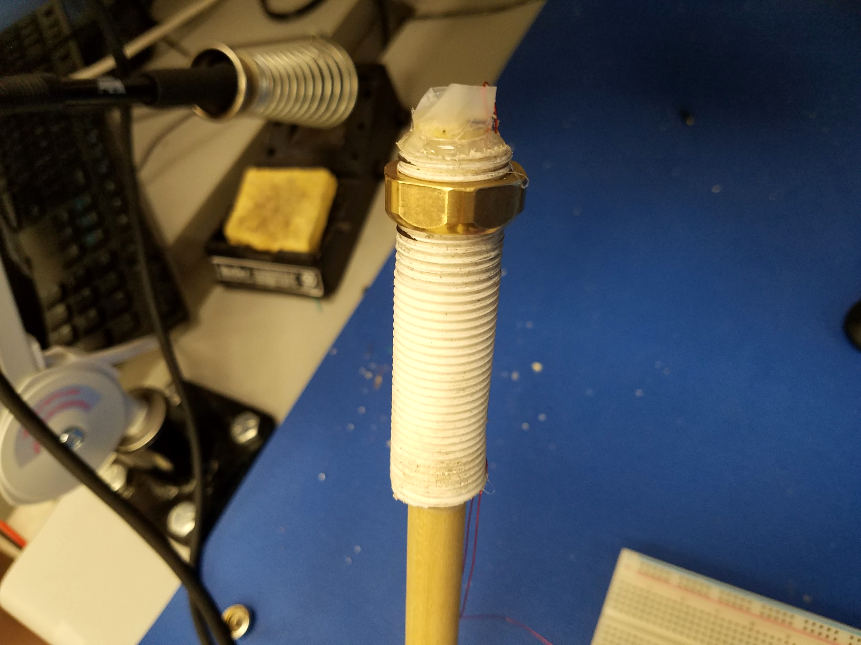
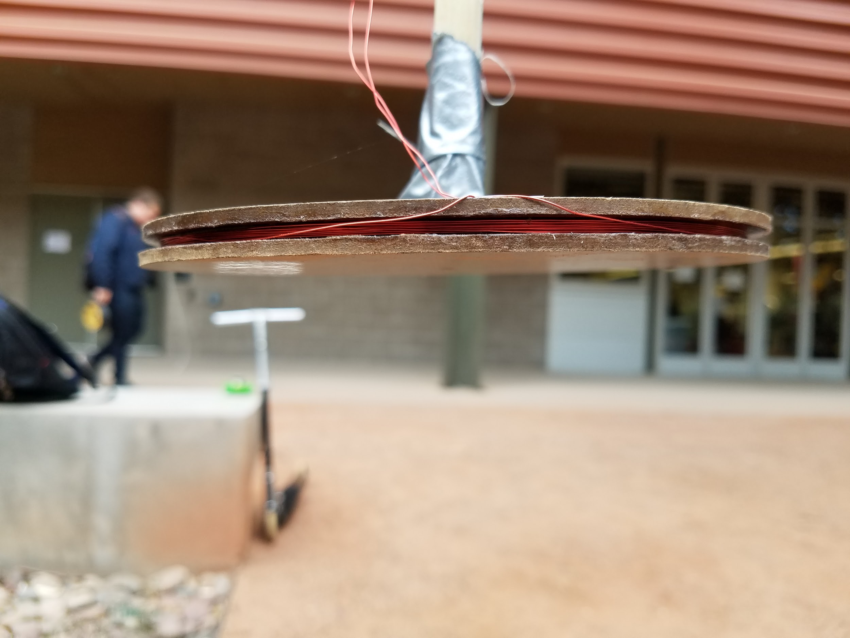
The Coils
Reference Coil
Two coil design with differing number of coil wraps
The reference coil has 125 wraps of wire
Housed in a threaded casing with a brass nut that can be used to tune the coil’s frequency.
The search coil has 10 wraps of wire
Portion of the metal detector that is down by the ground where it detects any changes.
Utilized a tuning process that put both coils at the same inductance.
When it comes close to metal, it changes the frequency which is then amplified and sent to the speaker where it can be detected as an audio difference.
Search Coil

Slide 7
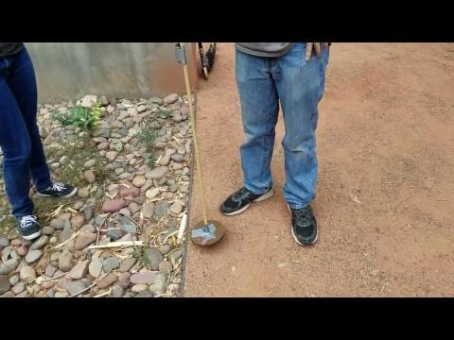
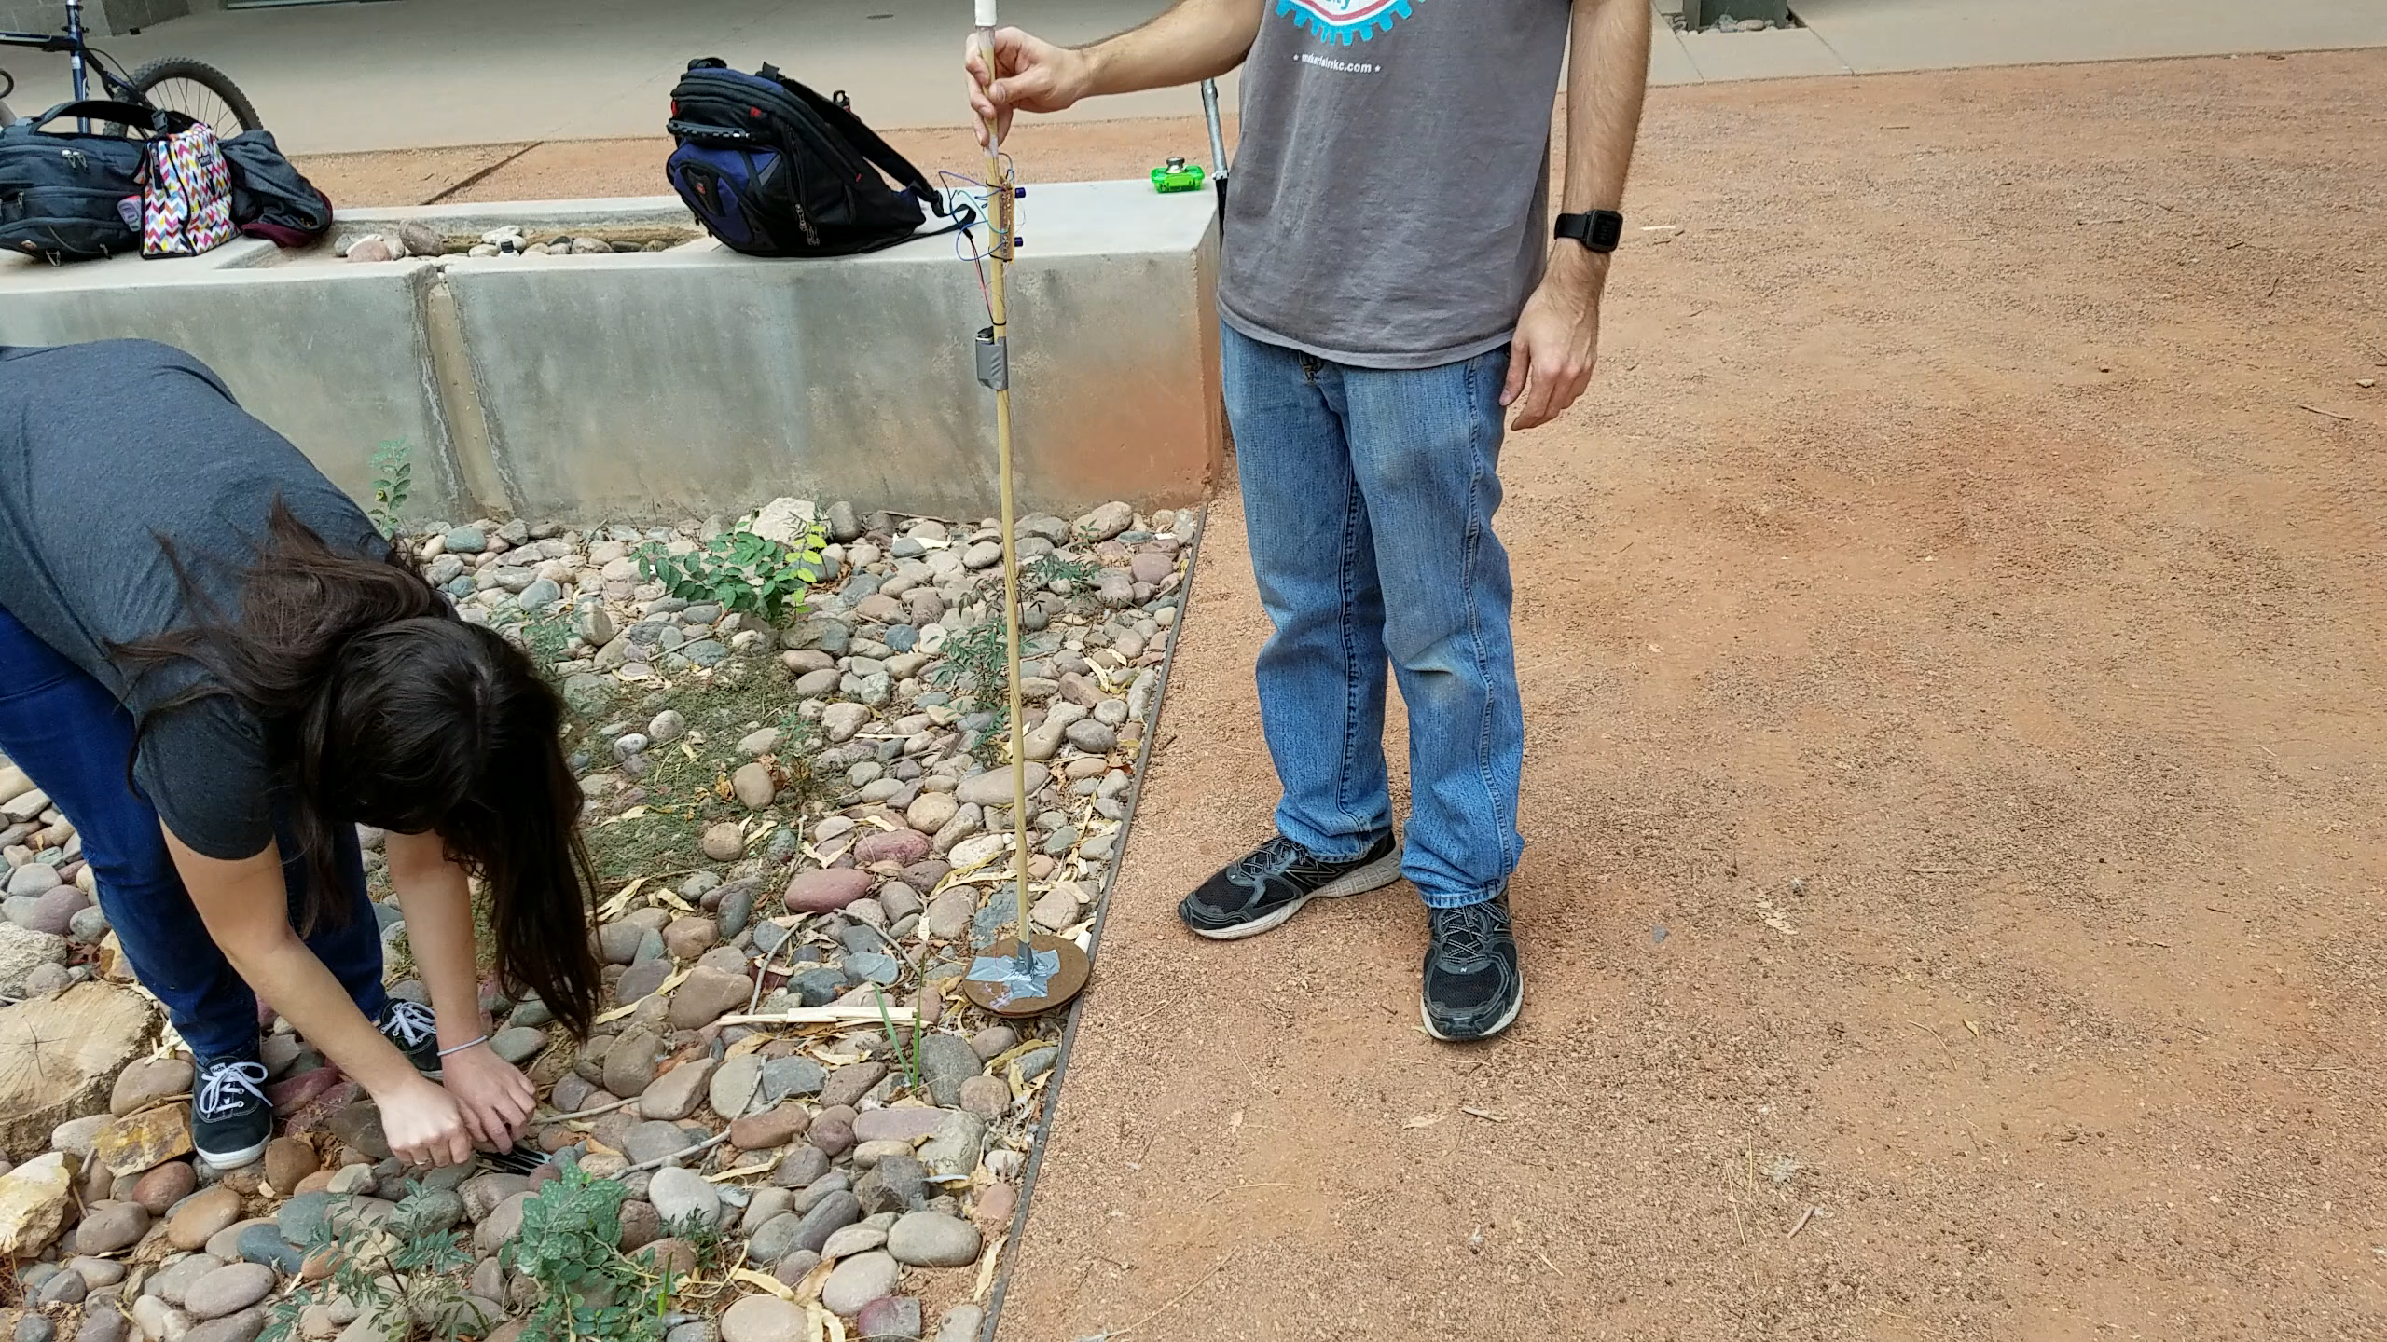
The Results
Overall success
Metal Detector has a generally small depth range
Objects have to be large to be picked up well

